Slide 1
Python Workshop part II
First half
Diffraction, luminescence, large datafiles and GitHub

Slide 2
Preparation (beforehand)
GitHub
Create a GitHub account (if done with @cam.ac.uk email you get PRO features)
Download GitHub desktop
Python
Have jupyter lab (or jupyter notebook) loaded
Nothing else
The first part of the practical is non interactive, so you don’t need to install any packages beforehand
This second part is interactive, so please do the following:

Slide 3

Diffraction analysis using python

Slide 4
Diffraction
Packages used
PyXem (multi-dimensional diffraction microscopy)
https://github.com/pyxem/pyxem
DiffPy (crystal structure files handeling)
https://github.com/diffpy/diffpy.structure
pyFAI (integrating 2D detector images to 1D profiles)
https://github.com/silx-kit/pyFAI
Tutorials
Bright field and dark field imaging from scanning electron diffraction
Phase mapping and strain mapping
Peak indexing and diffraction simulation
Radially integrating a detector image to a 1D profile
Notes:
Show my conda environment and conda list to show the packages are indeed installed.

Slide 5

Luminescence analysis using python

Slide 6
Luminescence packages
Packages used
Hyperspy (multidimensional data analysis tools)
Conda included packages (e.g Scipy (model fitting), numpy (matrices))
Tutorials
Fitting and getting a model for luminescence data and luminescence degradation

Slide 7

Large data files in python

Slide 8
Large datafiles
Packages used
Pandas (using dataframes == excel sheets for managing data)
Dask (numpy for huge datasets)
Tutorials
Simple pre-processing techniques to reduce loaded data
Binning
Sampling (with pandas)
Lazy data (with dask)
Advanced tools to load large files
Using remote desktops/clusters with large RAM memories (e.g. Google Colab for machine learning projects)
Releasing memory in Python (tricky but doable in iPython/Jupyter notebooks using magic commands) to avoid MemoryError

Slide 9

Github
Interactive part! Get ready…
Software development version control

Slide 10

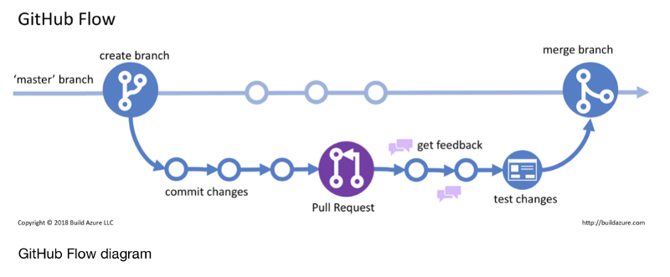
The github flow

Slide 11
Example shown first
I will edit my personal GitHub repository (because it is mine, the process is simpler, no need for forking)
https://github.com/jordiferrero/nanoDTC
I have realised an error in my code (spelling mistake)!
Files are already in my computer (show how local folder == GitHub cloud folder)
Edit locally my file (apply changes)
Load GitHub desktop (or run git diff) → shows differences
Commit changes
Push changes (loaded on the cloud)
Imagine I had a second computer with the same local folder, now it is outdated…
I would need to pull changes to get the latest version form GitHub

Slide 12
Your go!
Because you want to edit a repository that is not yours, you need to copy/fork and then apply changes.
Go to the example repository in jordiferrero/NanoDTC
Check for issues (or add one you want to work on)
Fork repository (so it becomes user_name/NanoDTC)
Sometimes you also need to create a new branch (1 branch = 1 issue) to solve different issues simultaneously. The default branch is the master branch
Clone your personal branch (either the master or the new_issue_branch) using GitHub desktop (notice it is saved in the Documents/Github/user_name folder) and now you can edit files in your computer
WORK ON THE ISSUE by changing files
Commit + Push files to your personal repository
Check you GitHub → changes have been uploaded!
Now you are ready to pull request your changes to the original repository 🎉!

Slide 13
YOUR CONTRIBUTION!
From GitHub create a pull request
Select the original branch (with your changes, by default master) and the repository and branch you want to change
Describe which changes you are adding
Reference the issue you are trying to solve
Now the responsible person of the main repository can accept and merge your changes or ask for a review.
NOTE: Any change you add to your personal repository branch will automatically be updated in your pull request ☺ (that’s why you keep one branch for every different pull request)
After your pull request has been accepted and merged, you will need to update your personal repository to the newest version of the original/upstream repository
Go to GitHub desktop
[Branch] → Merge into current branch… → upstream/master
Start again

Slide 14
Github extra
Create/Resolve an issue
Assign yourself to an issue
Automatize issue resolution to TO DO tasks
Contribute to a PR discussion
Use the Projects tab
Go back in time
Live in a multiverse (several versions of the same)

Slide 15
Q&A
Or send me any questions via email: jf631@cam.ac.uk

